Slide 1
RISC-V External Debug Security TG
Meeting notes – 1/15/2024

Slide 2
Disclaimer
https://docs.google.com/presentation/d/1LNhpuNwU54TgwGfcl-Fgf4HUFxCxh0AztPaeqMuRQRw/edit#slide=id.p1

Slide 3
Agenda
TG update
Arch opens

Slide 4
Introduction
Welcome to TG meeting
Feel free to raise your hand and introduce yourself

Slide 5
New meeting time
Tuesday 3pm, every other week from 1/30 (NOT Monday)

Slide 6
Spec Repo
Official repo created https://github.com/riscv-non-isa/riscv-external-debug-security
Plan to move proposal from https://github.com/joxie/riscv-debug-security to offical repo in the next two weeks

Slide 7
Extension Management
ISA extension
https://github.com/riscv/riscv-smmtt
Non-ISA extension
https://github.com/riscv-non-isa/riscv-external-debug-security

Slide 8
Arch Opens
Aote Jin

Slide 9
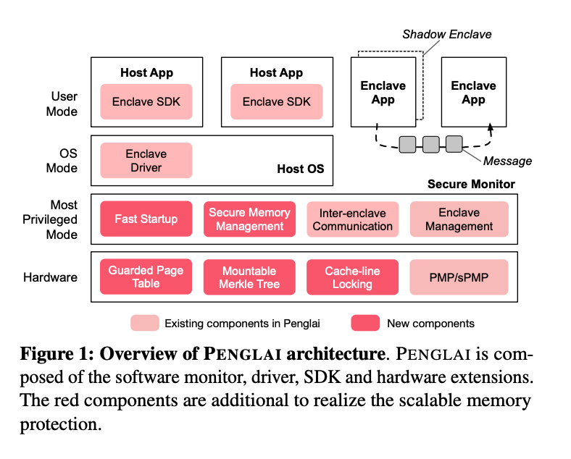
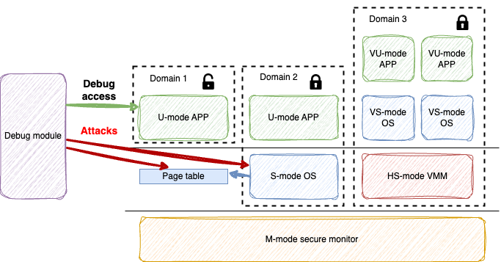
(Potential) Privilege escalation issue

Slide 10
Cont’d
What is the concern?
Debugger grants higher privilege level
To debug U mode domain, debugger grants S priv. level
Is this a real threat?
Need more research and (potentially) PoC
Read Perf counter, manipulate timer/interrupt
Modify page table to compromise other domain*
Solution space?
(Arch) Add an optional nob to regulate U-mode debug?
(SW) Enclave model SW to create S mode layer to provide self-host debug service
* - PMP can be used to mitigate this threat, but PMP entries are precious

Slide 11
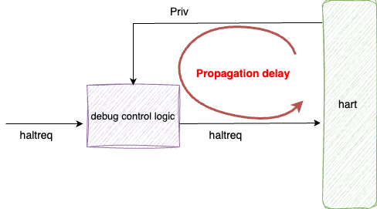
Toctou issue
The Issue
The logic to check haltreq might be far away from the hart
Debug control check passes, but hart changes to a undebuggable privilege mode when haltreq arrives hart
Mitigation
Implementations to guarantee?
No privilege change during trigger firing/matching
Haltreq check logic close to the hart

Slide 12
Proposal to mitigate
Implementation must assure no privilege change between the debug control check and serving the debug request
E.g. implement the debug control logic close to hart or inside the hart
Mandate that no privilege change during trigger firing/matching

Slide 13
Backward compatibility
Option 1: not back compatible
Debugger polling alledsec/anyedsec in dmstatus to determine whether External Debug Security extension is available in hart
If available, the debug operation will be different
Need to program dcsr to get M-mode accessibility
Option 2: partially back compatible when M-mode is debugable
When M-mode is debuggable, hart behaves as no External Debug Security
Relaxedpriv still hardwired to 0x0
System Bus Access still honors bus initiator protection e.g. IOPMP

Slide 14
External trigger privilege control
External trigger missing M/S/VS/VU enable bits in tmexttrigger
S-mode debugger might attack M-mode by external trigger (e.g. DoS, side channel)
External trigger inputs might have resource belongs to M-mode
Since M-Mode is enabled by RoT, external triggers should be enabled by RoT as well

Slide 15
Proposal to mitigate
Add per privilege enable bits like other triggers
Mandate that external trigger shall only be enabled by RoT and lockable

Slide 16
Defeature ndmreset
Ndmreset is a system level reset which is not associated with hart privilege and can only be protected by system; thus it shall be defeatured.

Slide 17
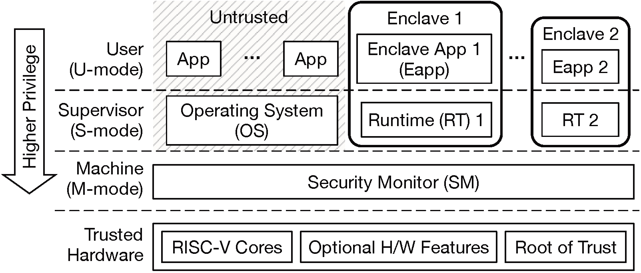
Keystone

Slide 18
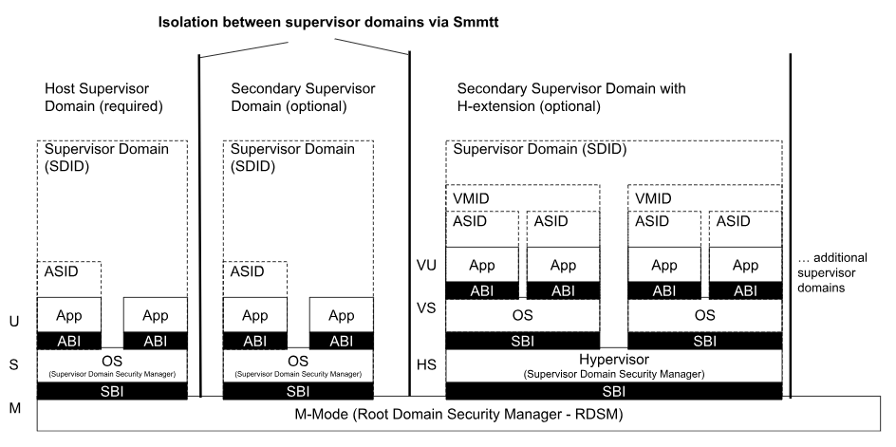
Smmtt

Slide 19
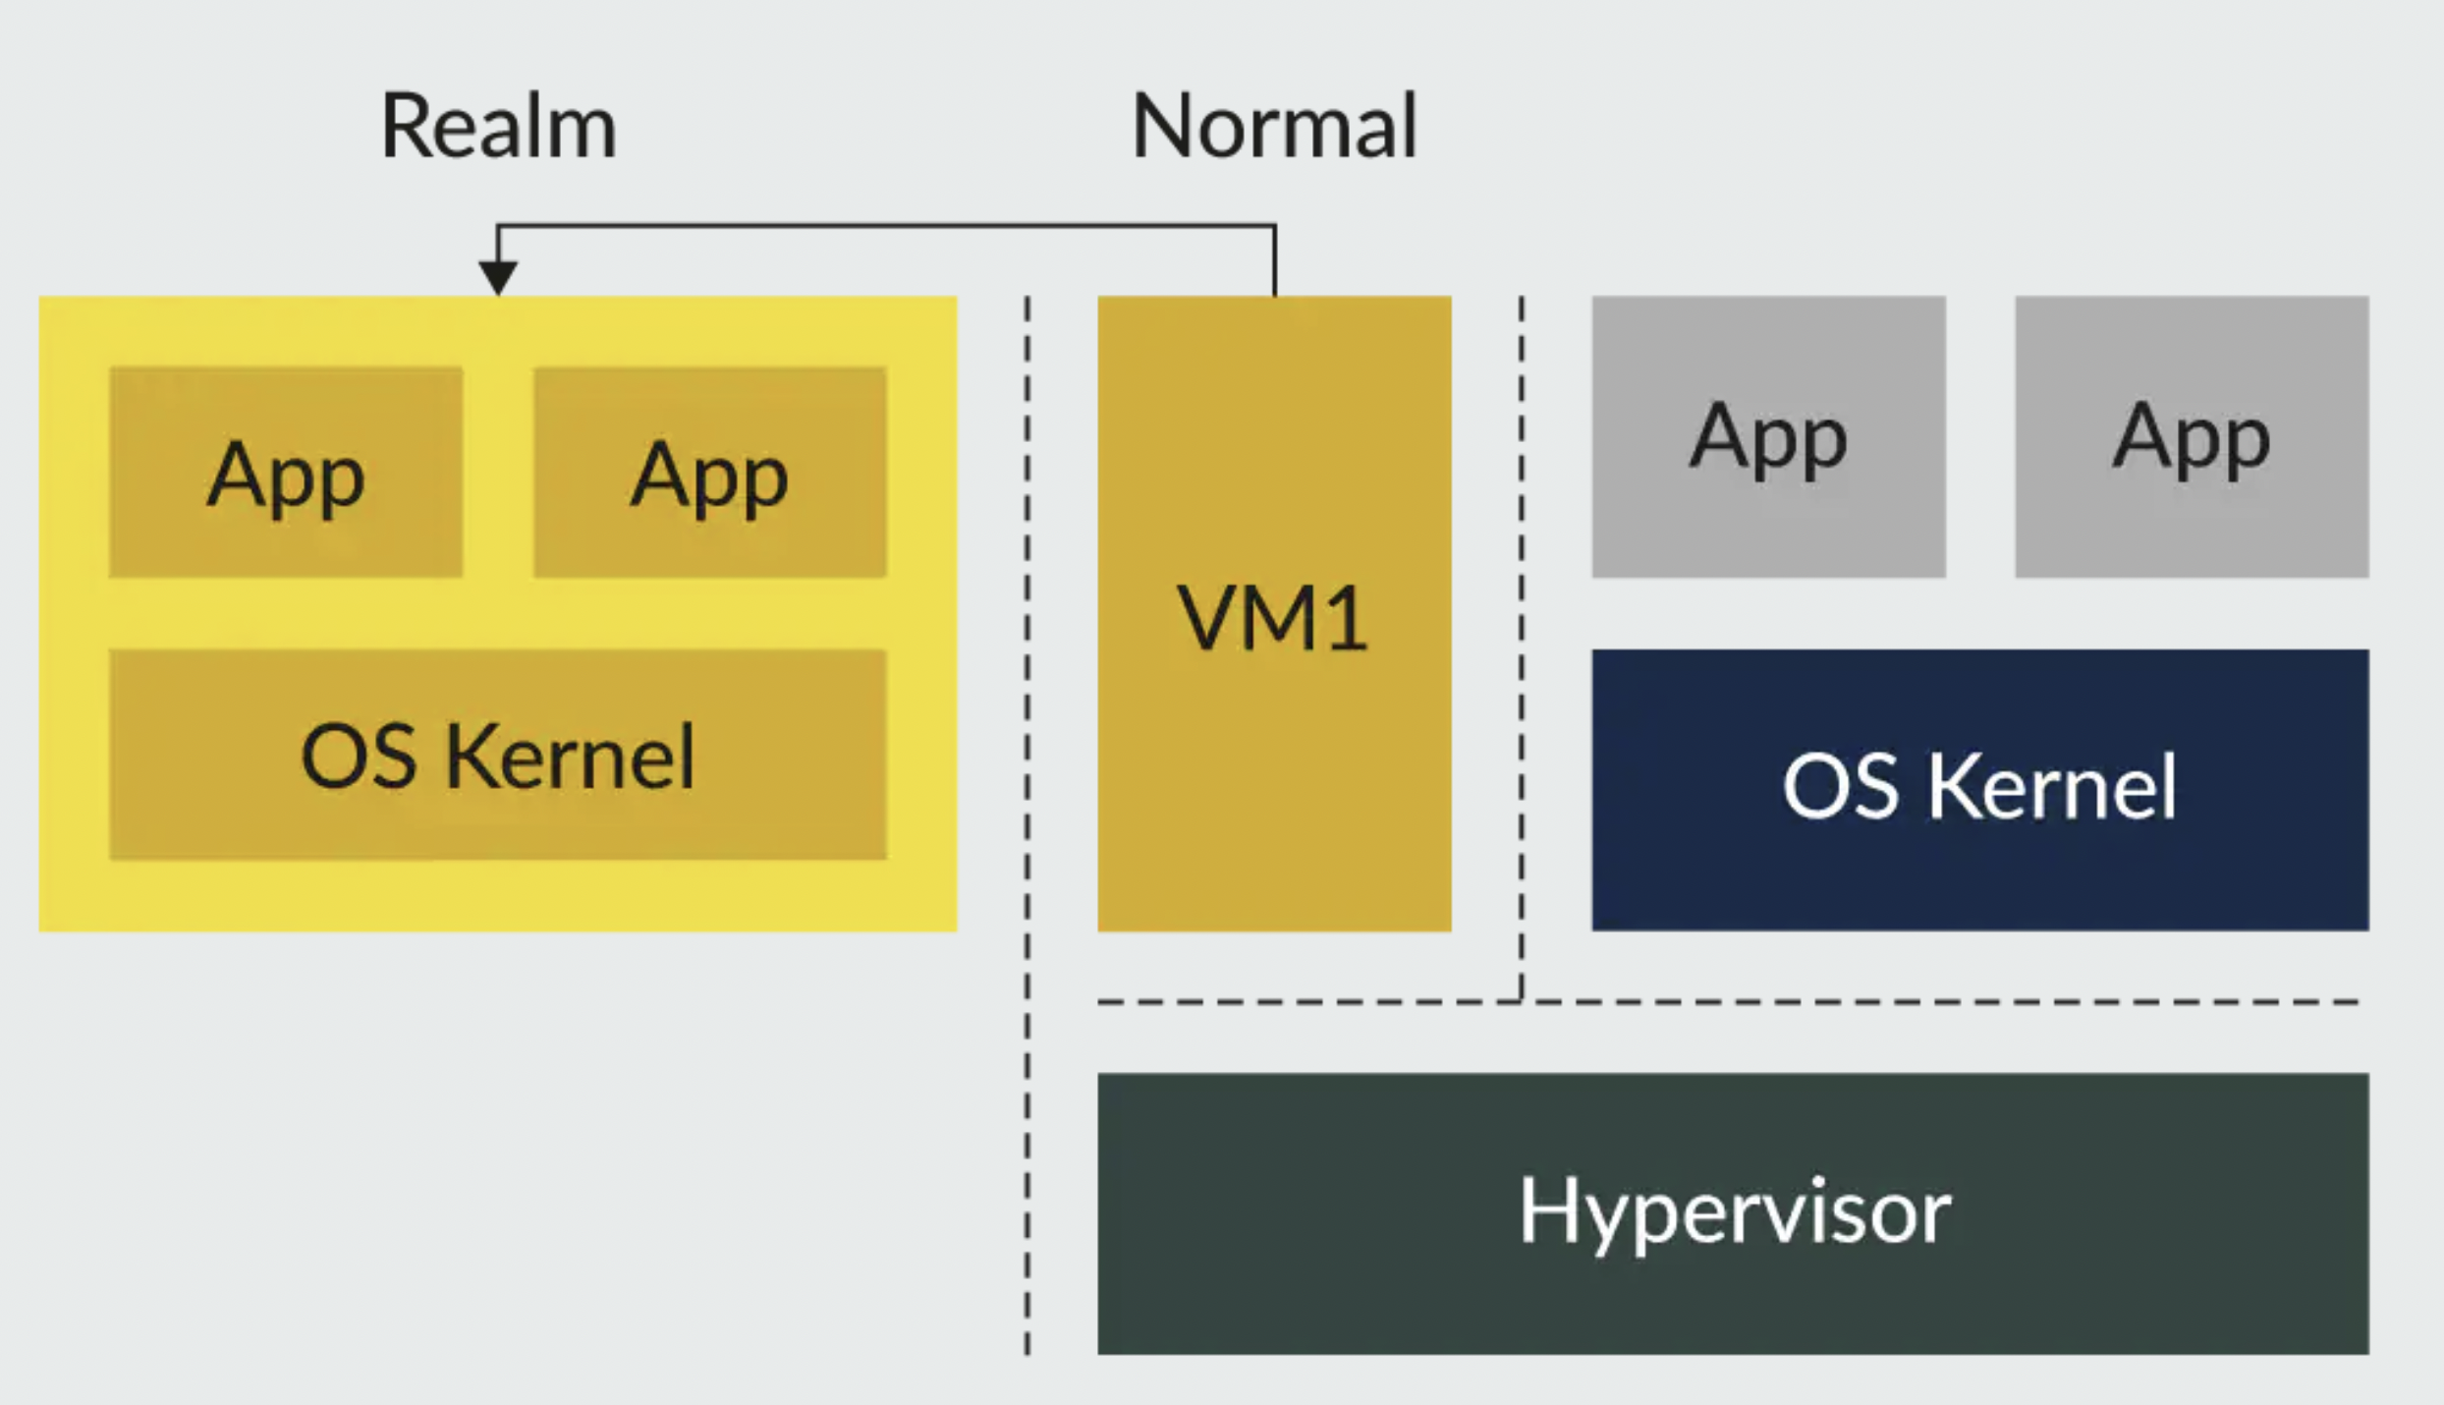

Slide 20
Notes
Priv escalation
Need more info to decide between spec fix vs SW mitigation
NXP already introduced customized u-mode debug control
AI – Joe to check with Penglai people
AI - Aote to update original issue with the new findings (https://github.com/riscv/riscv-smmtt/issues/11)
TocTou issue
Prefer to update diagram, move haltreq checker loggic into hart
AI – Aote to create a new issue in Smmtt repo
Backcompatiblity issue
AI – Joe to check with debugger SW guys

Slide 21
Backup Slides

